Slide 1
BAILEY DETENTION POND IMPROVEMENTS
Bid no. 20-042

Slide 2
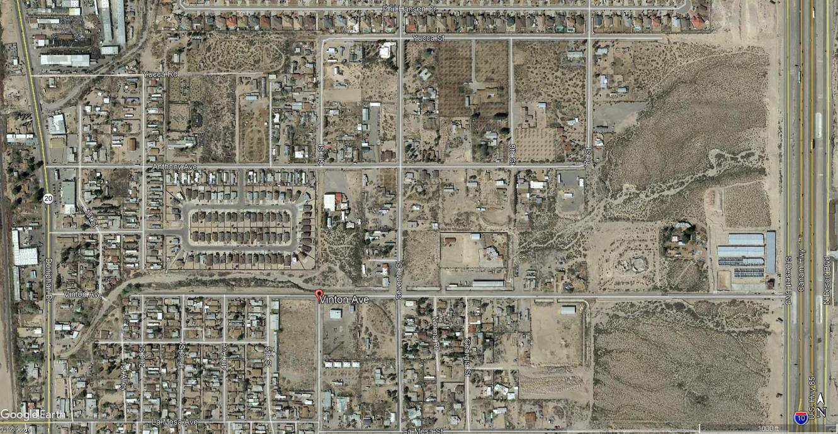
PROJECT LOCATION
Located in the Town of Canutillo, Texas the project lies near the residential area known as Bailey Subdivision, approximately 3,000 feet west of I-10 on Vinton Avenue.

Slide 3
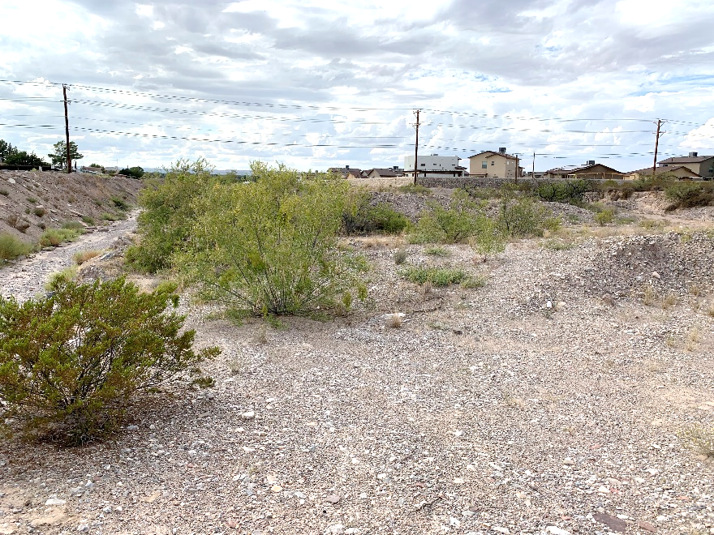
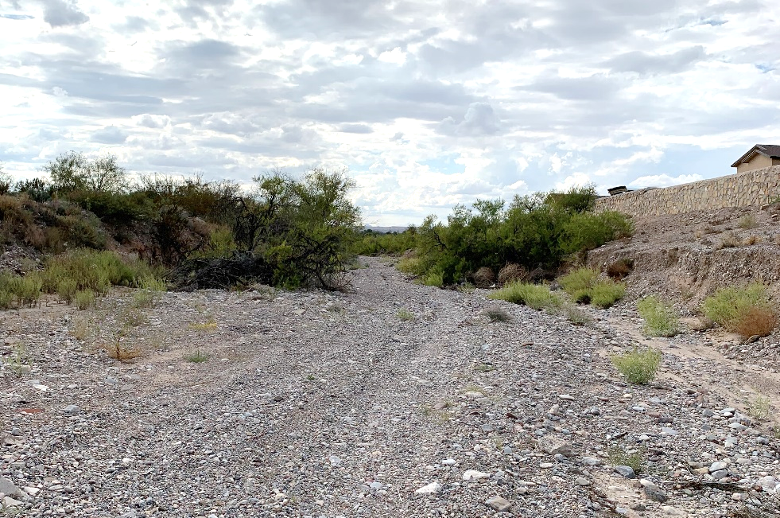
PROJECT DESCRIPTION
The site of the proposed detention pond is located in the path of an arroyo extending along the northside of Vinton Avenue from approximately 2nd Street to 7th Street.
The project will a create series of detention basins to mitigate impacts to the downstream properties.
Photo 1 – Existing Natural Ground
Photo 2 – Arroyo Path

Slide 4
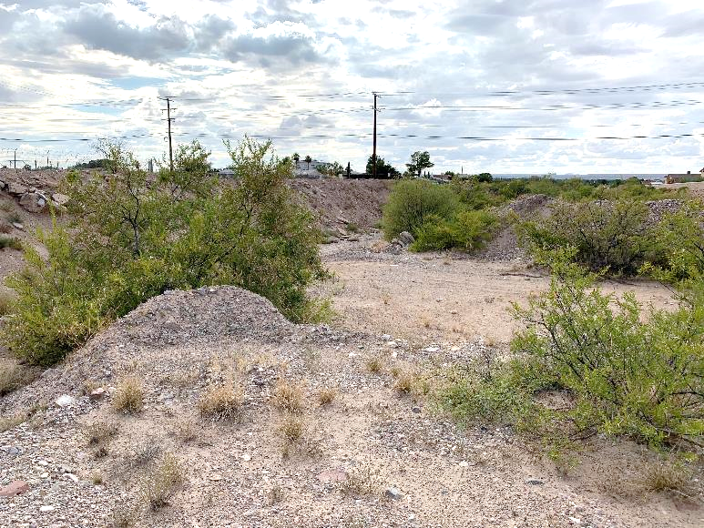
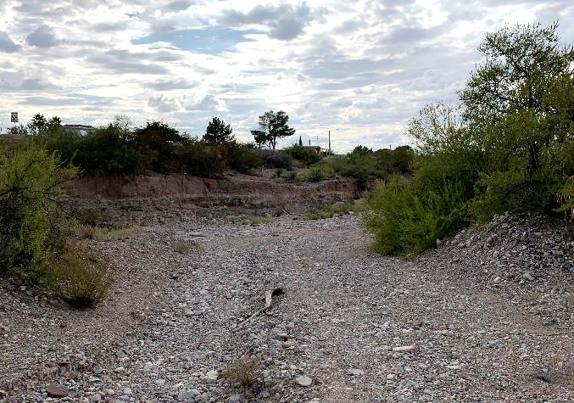
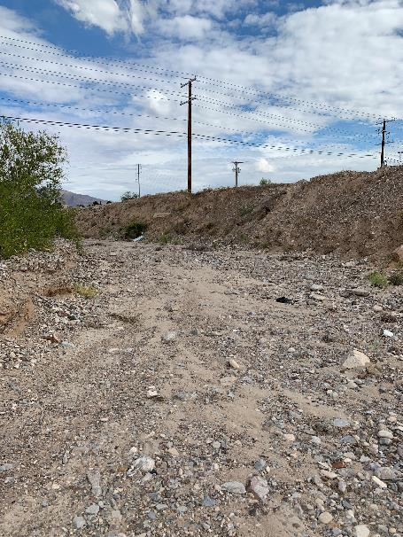
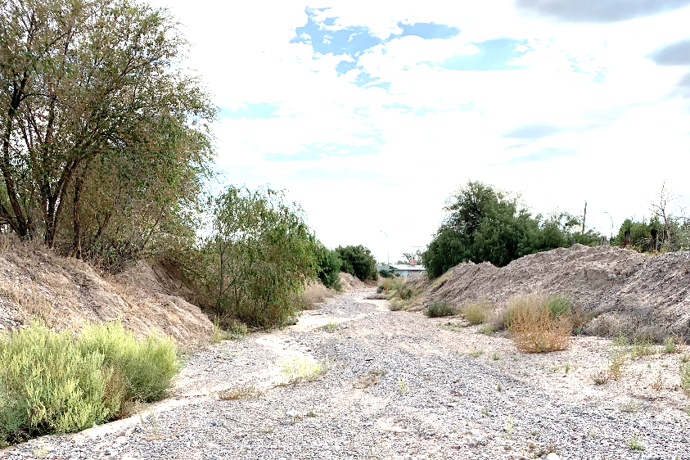
PROJECT DESCRIPTION
Existing conditions
Existing stormwater runoff flow

Slide 5
PROPOSED IMPROVEMENTS
Site clearing and grubbing
Implementation of traffic control plan
Excavation of unclassified material
Installation of drainage improvements including rock rip-rap, baffle block dissipator structures, base material, reinforced concrete flumes, and concrete spillway structures
Installation of site improvements including rockwalls, retaining walls, wrought iron fence and gate.

Slide 6
QUESTIONS?

