Slide 1
MEDICALLY CERTIFIED
FOR DISABLED PARKING

Slide 2
Texas Senate Bill 792
Effective January 1, 2022, anyone parking in a disabled parking space must have a disabled person license plate or a disabled parking placard that features the International Symbol of Access (ISA), commonly referred to as the wheelchair emblem.
Veterans with Disabled Veteran license plates wishing to use the disabled parking spaces must apply for a disabled parking placard or a new disabled veteran license plate featuring the ISA. The veteran must meet the requirements to be medically certified for a disabled parking placard or disabled person license plate featuring the ISA.
NOTE: Not all service connected disabilities that qualify a veteran for Disabled Veteran license plates will qualify a veteran as medically certified for a Disabled Veteran license plate featuring the ISA.

Slide 3
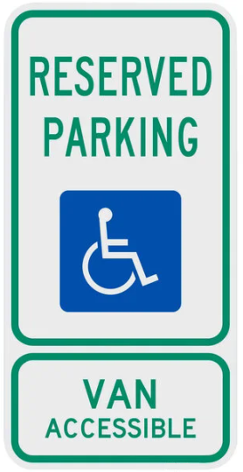
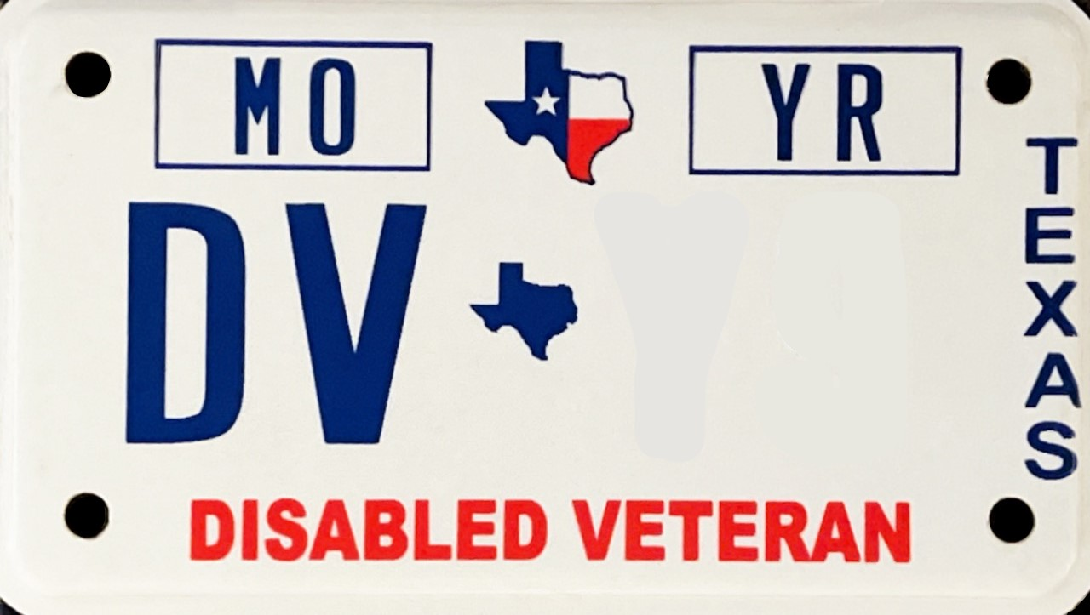
Table 1-1: License Plates Not Authorized
License Plate Types
NOT ALLOWED to Park in Disabled Spaces
These license plates cannot park in the Disabled Spaces because they do not have the ISA, the wheelchair emblem, on them.

Slide 4
Table 1-2: Penalty Fees
1st Offense:
No less than $500 or more than $750;
2nd Offense:
No less than $500 or more than $800; and
No less than 20 or more than 30 hours of community service;
3rd Offense:
No less than $550 or more than $800; and
20 hours of community service;
4th Offense:
No less than $800 or more than $1,100; and
30 hours of community service;
5th Offense:
$1,250; and
50 hours of community service

Slide 5
Can I be Medically Certified?
Although you have service connected disabilities your eligibility may not qualify you to be medically certified.
Transportation Code, Section 681.001(2) defines a disability as a condition in which a person has:
mobility problems that substantially impair the person's ability to ambulate;
Such not being able to walk 200 feet without stopping or without assistance from a device (brace, cane, crutch, prosthetic) or ambulate without a wheelchair; or
Such as being restricted by lung disease (the person’s forced respiratory expiratory volume for one second is less than 1 L or the arterial oxygen tension is less than 60 mm or uses portable oxygen: or
Such as a cardiac condition that the person’s functional limitations are classified as Class III or IV; or
Such as severely limited in the ability to walk because of an arthritic, neurological, or orthopedic condition or because of a disorder of the foot;
visual acuity of 20/200 or less in the better eye with correcting lenses; or
visual acuity of more than 20/200 but with a limited field of vision in which the widest diameter of the visual field subtends an angle of 20 degrees or less.

Slide 6
How to Become Medically Certified
If you are a Disabled Veteran certified by the U.S. Department of Veterans Affairs:
Have a service connected disability rating of 50% or more; or
Have or a service connected disability rating of 40% or more due to amputation of a lower extremity;
Use the Form VTR-615 Application for Disabled Veteran License Plates and/or Parking Placards to select the type of military plate you are requesting.
The form is available to print at www.txdmv.gov (using the Search Box, type in VTR-615).

Slide 7
How to Become Medically Certified
If you DO NOT qualify as a Disabled Veteran with an overall service connected disability rating, but have a qualified disability you may use the form VTR-214 Application for Persons with Disabilities Parking Placard and/or License Plate.
The form is available to print at www.txdmv.gov (using the Search Box, type in VTR-214).

Slide 8
Licensed Medical Professional
A licensed medical professional must medically certify you by completing the “Disability Statement” on your form. (Page 3 of the VTR-615 or Page 2 of the VTR-214)
Required information:
Your name as the person with the disability; and
Type of disability (permanent or temporary); and
The licensed medical professional’s:
Name;
Professional license number;
Date form was signed;
Signature;
Address of practice.

Slide 9
Notary or Prescription (Rx)
Notary section must contain date signature was witnessed, licensed medical professional’s name, location of notarization (state and county), notary public’s name, and when notary’s commission expires.
Or the licensed medical professional can provide you with an original prescription containing your name as the disabled person, a statement if the disability is permanent or temporary, and their signature.

Slide 10
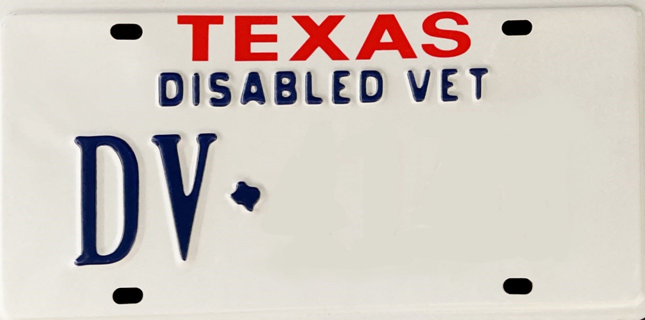
Table 1-3: Authorized Parking
Submit your Form VTR-615 to the County Tax Assessor Collector’s office.
Submit your Form VTR-214 to the County Tax Assessor Collector’s office or the Contracted Full Service Deputy offices.

