Slide 1


CELESTE DRIVE DRAINAGE IMPROVEMENTS
Bid no. 20-041

Slide 2
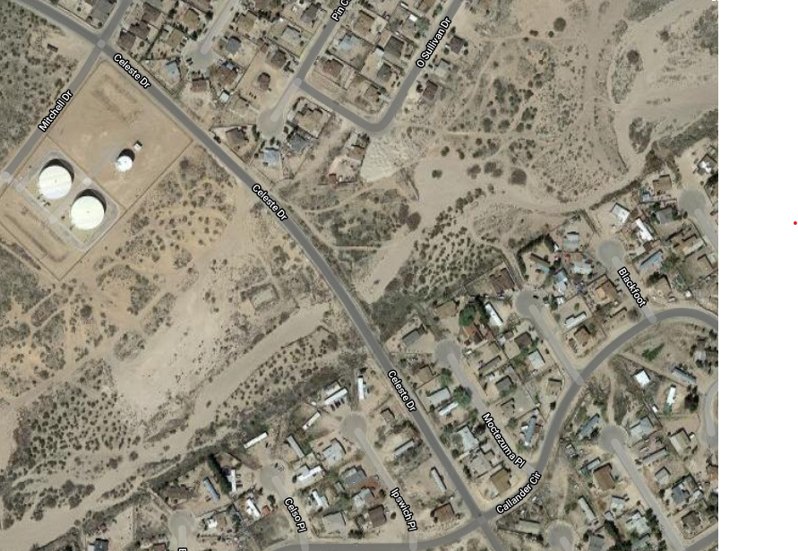
PROJECT LOCATION
  Located in East El Paso County, Texas, the project lies near the residential area known as El Paso Hills, approximately 400 feet south of Mitchell Drive

Slide 3
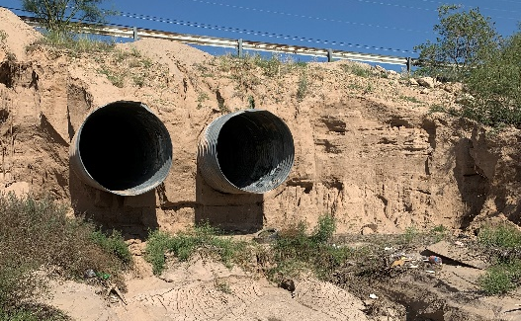
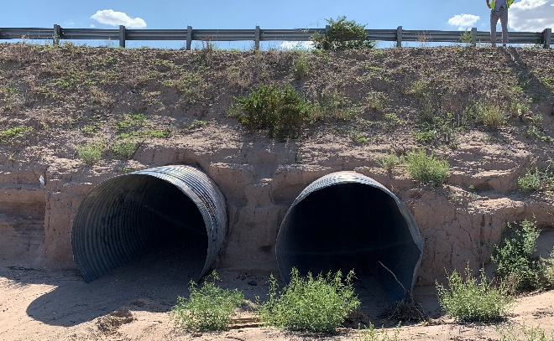
PROJECT DESCRIPTION
  The project will repair and improve the existing drainage crossing under Celeste Drive
  The existing crossing consists of two corrugated metal pipes (CMPs) laid along a natural arroyo, that extend beyond the roadway earthen embankment with no headwalls and/or riprap
  The embankment is eroded and the CMPs have been undermined at the downstream end of the crossing due to the lack of erosion control
Photo 1 – CMPs downstream of Celeste Dr.
Photo 2 – CMPs upstream of Celeste Dr.

Slide 4
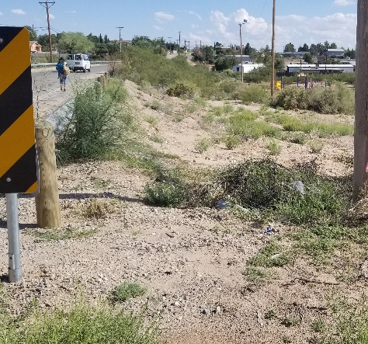
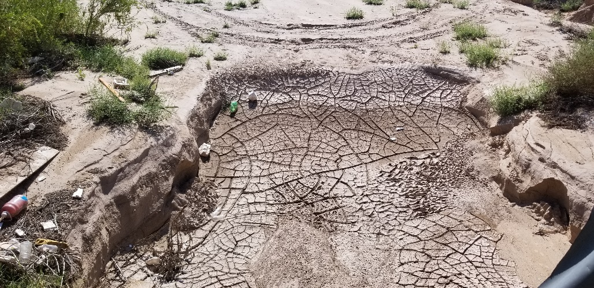
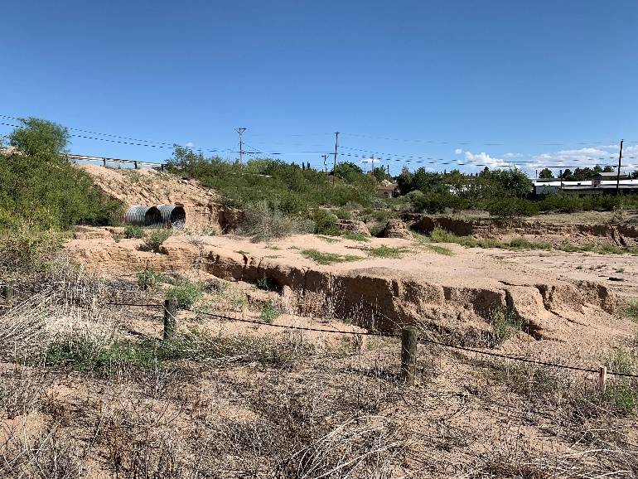
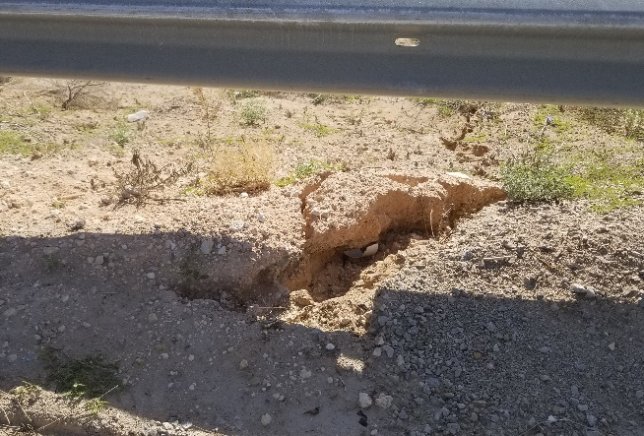
PROJECT DESCRIPTION
Erosion along and downstream of Celeste Dr.

Slide 5
PROPOSED IMPROVEMENTS
  Site clearing and grubbing
  Implementation of traffic control plan
  Repair and improve the existing drainage crossing under Celeste Drive
  Excavation of unclassified material
  Installation of drainage improvements including gabion baskets, concrete riprap, mortared rock riprap, headwalls, wingwalls, reinforced concrete flumes, and concrete energy dissipation structures
  Installation of site improvements including concrete curb and gutters

Slide 6
QUESTIONS?

