Slide 1


TORNILLO DETENTION POND IMPROVEMENTS
Bid no. 20-043

Slide 2
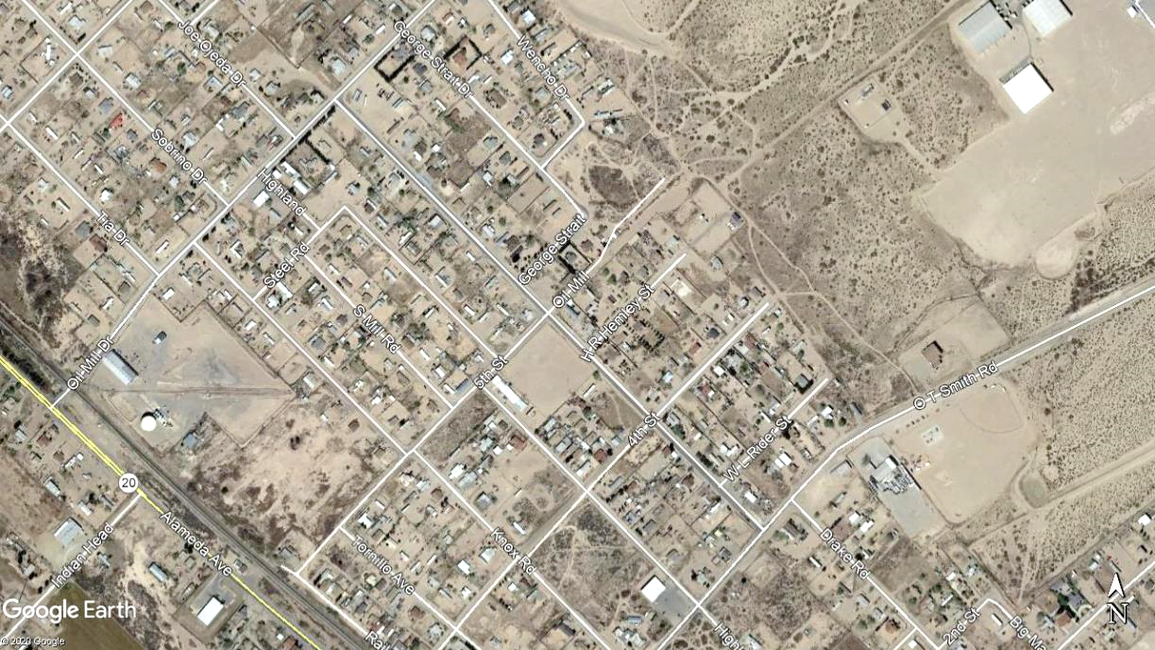
PROJECT LOCATION
  Located in Tornillo, Texas the project lies near the residential area known as Drake Subdivision unit 7, approximately 900 feet north of Alameda Avenue on George Strait Drive. The property is owned by the County of el Paso.

Slide 3
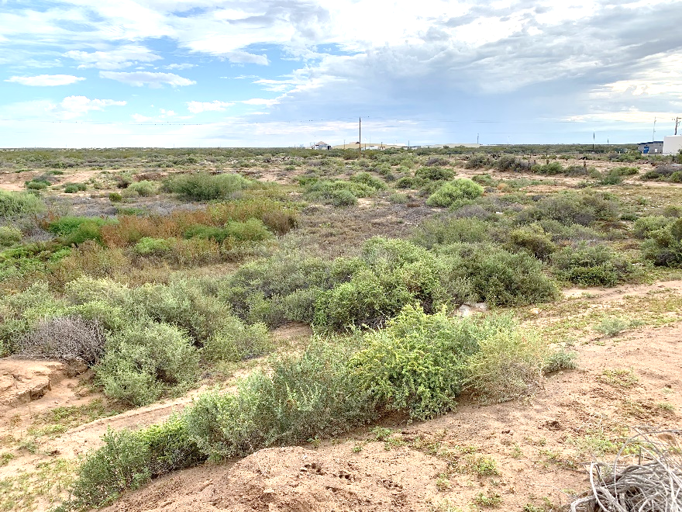
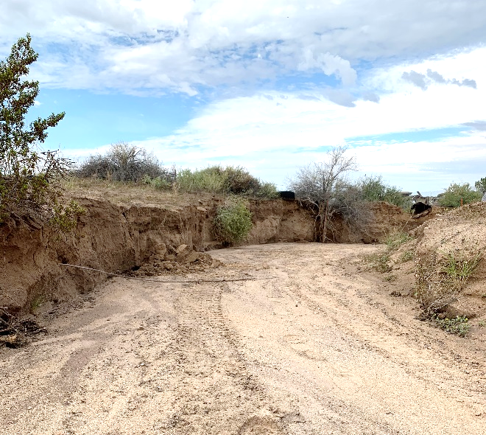
PROJECT DESCRIPTION
  The site of the proposed detention pond is located in the path of a flow path/arroyo extending from the Manny Aguilera Boulevard (FM 3380) to Alameda Avenue (SH 20).
  The site is generally bounded by Wencho Drive, George Strait Drive, and 5th Street encompassing approximately 5 acres.
  A portion of the Project site lies in an ephemeral stream/arroyo designated flood area.
  The goal of the County is to mitigate impacts to downstream properties and streets by capturing and detaining the flows in the arroyo.
Photo 1 – Existing Natural Ground
Photo 2 – Arroyo Path

Slide 4
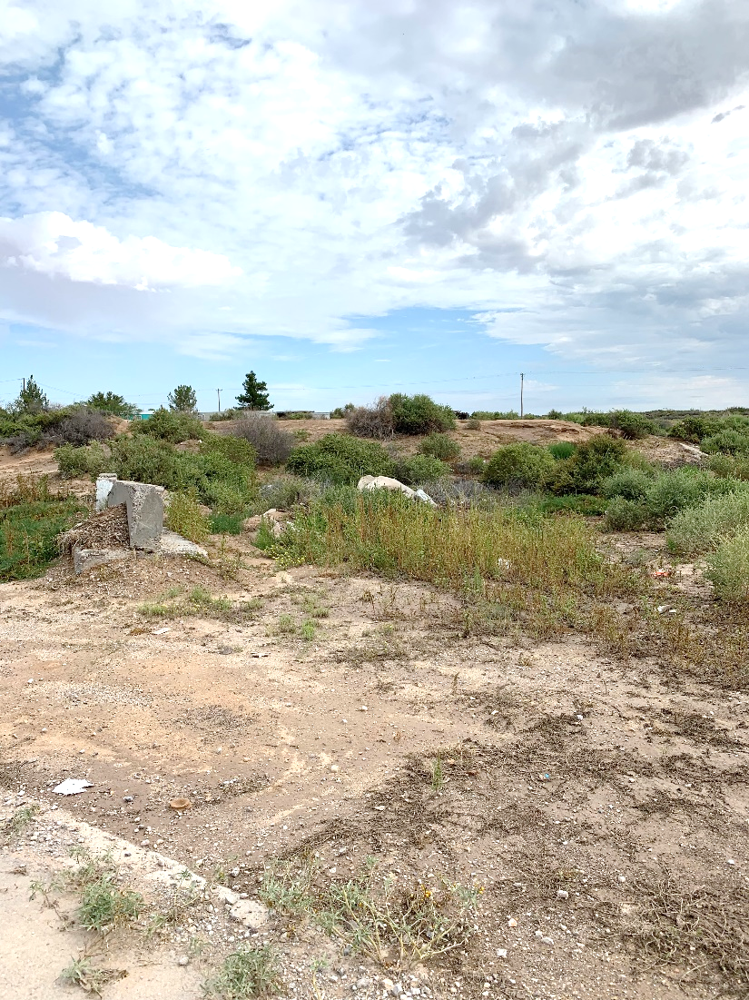
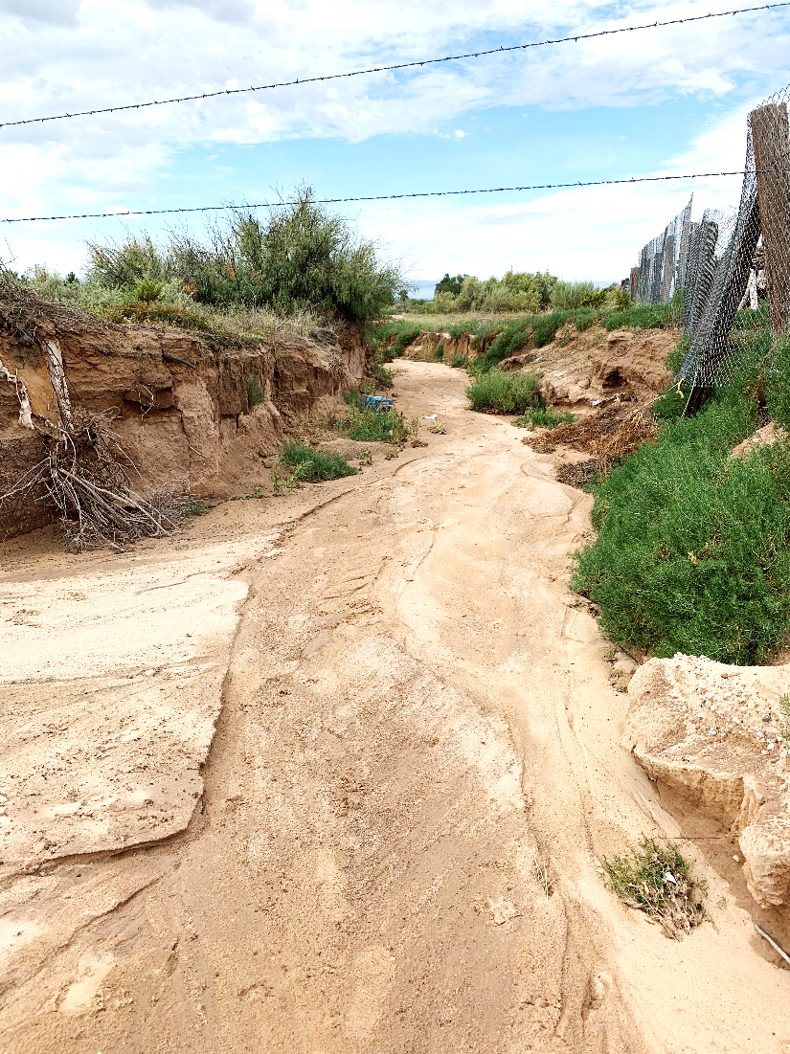
PROJECT DESCRIPTION
Existing conditions
Existing stormwater runoff flow
The lands upstream are owned by the General Land Office
There may be a 6-inch waterline owned by the Lower Valley Water Improvement District along the upper perimeter of the site

Slide 5
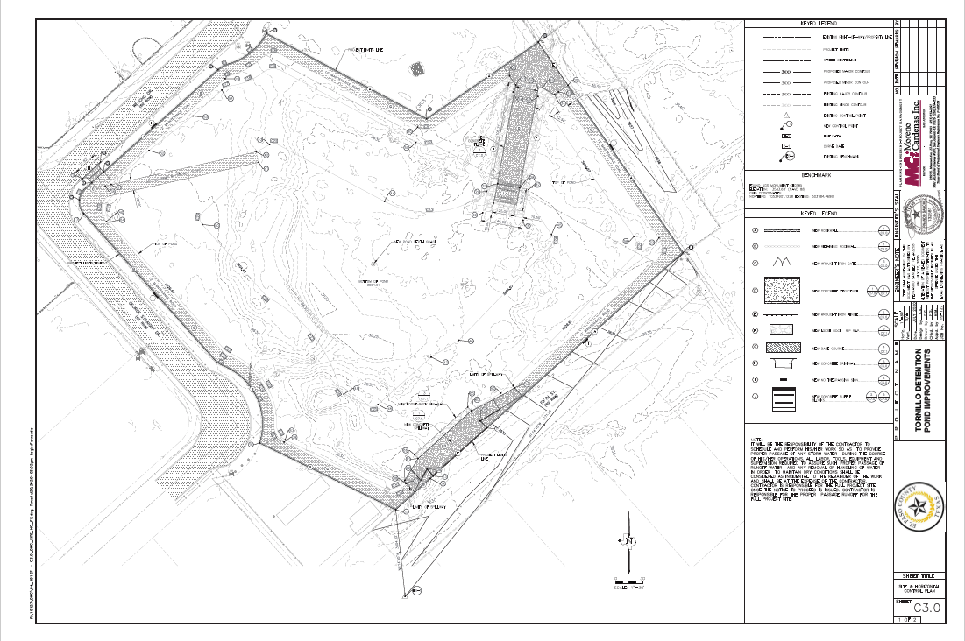
PROPOSED IMPROVEMENTS
  Site clearing and grubbing
  Implementation of traffic control plan
  Excavation of unclassified material
  Installation of drainage improvements including rock rip-rap, baffle block dissipator structures, base material, reinforced concrete flume, and concrete spillway structure
  Installation of site improvements including rockwalls, retaining walls, wrought iron fence and gate.

Slide 6
QUESTIONS?

