Slide 1
Registering For eRecording
El Paso County Clerk’s Recording Division
Angela Escarsega, Administrative Services Manager
Cassandra Magana, Customer Relations Specialist Senior
Naythan Fraire, Customer Relations Specialist Senior
(915) 546-2074 CountyeRecording@epcounty.com
Prepared by the El Paso County Clerk’s Office

Slide 2
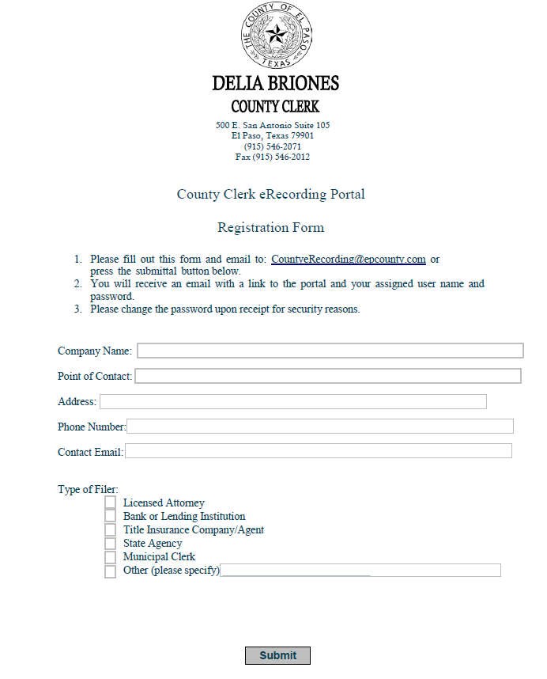
How to Register for eRecording
Please visit http://apps.epcounty.com/erecording and download the registration form.
Please note that eRecording is currently only available to authorized filers listed under Local Government Code Section 195.003(a).
Email your form and any questions you may have to CountyeRecording@epcounty.com

Slide 3
Registration Confirmation Email

Slide 4
eRecording in Four Easy Steps
Submit your document/package through the eRecording Portal.
The County Clerk’s Office will review and accept filings during regular business hours.
Pay for your package in the pending payments section of eRecording. We are currently only accepting major credit cards and Escrow account payment
Once payment is approved, documents will be automatically recorded and assigned an instrument number.
Credit Card Convenience Fees
Under $87.00 | $1.95
Over $87.00 | 2.25% of total amount
Submit your documents to record
Receive recorded documents electronically
Pay for the packages
Wait for documents to be accepted

Slide 5
Submitting Your Documents
1. Log onto www.epcounty.com/eRecording once you have received your username and password.
2. Click on the Create Package link at the top to being creating your document package for review.

Slide 6
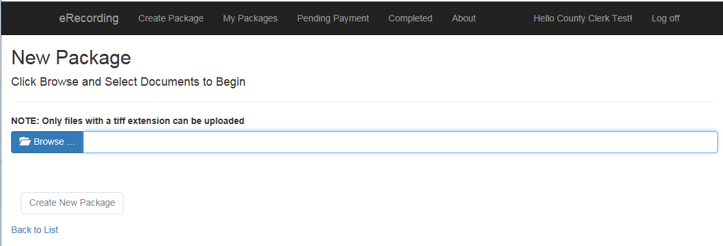
Submitting Your Documents (cont.)
3. You will be directed to the New Package screen where you will upload and submit TIFF imaged documents. Do not save documents using special characters (Ex: , . / ? ! ’ - &).

Slide 7
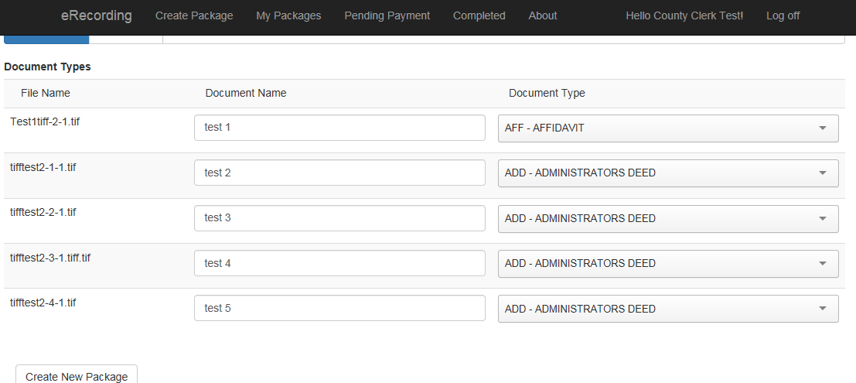
Submitting Your Documents (cont.)
4. Once your documents have uploaded, enter a document name and type, then click Create new Package.

Slide 8
Submitting Your Document (cont.)
5. You will be directed to the My Packages screen where you will be able to view the package you created, the amount of documents, estimated cost (convenience fees not included) and have the option to submit the package or recall if necessary.

Slide 9
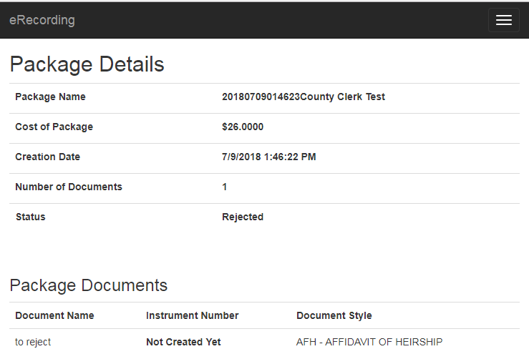
Rejected Documents
6. If something is found to be incorrect, the entire package will be rejected. You will have to recreate and submit the package again.

Slide 10
Payments
All documents are immediately recorded UPON payment
once they have been reviewed and accepted by the County Clerk’s Office.
Payments for all electronically recorded documents will be processed through the County’s credit card vendor. (VPS)
eRecording accepts all major credit cards.
We are also accepting payments using Escrow accounts. To set up and Escrow account please contact the County Clerks Office for more details.
At this time, checks and cash payments are not available.
Credit card convenience fees will apply to all transactions as follows.
$1.95 to all transactions under $87.00
2.25% of total for transactions over $87.00

Slide 11
Why eRecording?
If you are an authorized filer pursuant to Local Government Code Section 195.003(a), you can save money with eRecording
Save on paper and toner by submitting documents electronically.
Save a trip to the courthouse and submit from the comfort of your own office.
Submit up to 10 packets and pay for them in one single transaction.

Slide 12
FAQ
Will there be any extra costs associated with eRecording?
Aside from recording fees and any convenience fees associated with credit card payments, there are no additional fees.
Once a package is rejected can it be accepted afterwards?
A package cannot be amended after being rejected. A new package will have to be created.
If a mistake is made after my package has been approved but before payment, can it still be recalled?
Yes, a package can be recalled any time before payment is made.
Where can I check the status of my submitted documents?
Please visit the MY PACKAGES section of your eRecording account. Please be proactive in checking status and paying for packages that have been approved by our office.

